Slide 1
Track D rapporteurs: Social, behavioural and implementation science
Sergio Bautista-Arredondo
National Institute of Public Health
Mexico
Share your thoughts on this presentation with #IAS2019

Slide 2
Track D rapporteurs team
Sergio Bautista – Mexico
Inés Aristegui – Argentina
Arantxa Colchero -- Mexico
Heleen Vermandere –Belgium/Mexico
Diego Cerecero – Mexico
Paola Gadsden - Mexico

Slide 3
Background
Implementation science + social and behavioural science
Progress towards 90-90-90 targets
Evidence on and innovations in implementation strategies
  Scale up successful interventions – PrEP
  Reaching key populations, link them to HIV services, and keep those already engaged
  Impact of programs and policies
Challenges: Barriers for acceptability, access, retention
  Structural, local, and individual factors
Financing and efficiency aspects of program implementation

Slide 4
Overview: Social, behavioural and implementation science
Accurate and timely data is the core of good programming design, implementation, and evolution of programs
Involvement of the community is critical for programmatic success
Community involvement all along. Designing interventions and generating evidence
Culturally mindful interventions that address structural complex barriers and problems
  Stigma and decisions – impact of stigma along the cascade
Laws and context exacerbate or alleviate vulnerability and risk

Slide 5
Accurate and timely data is the core of good programming design, implementation, and evolution of programs

Slide 6
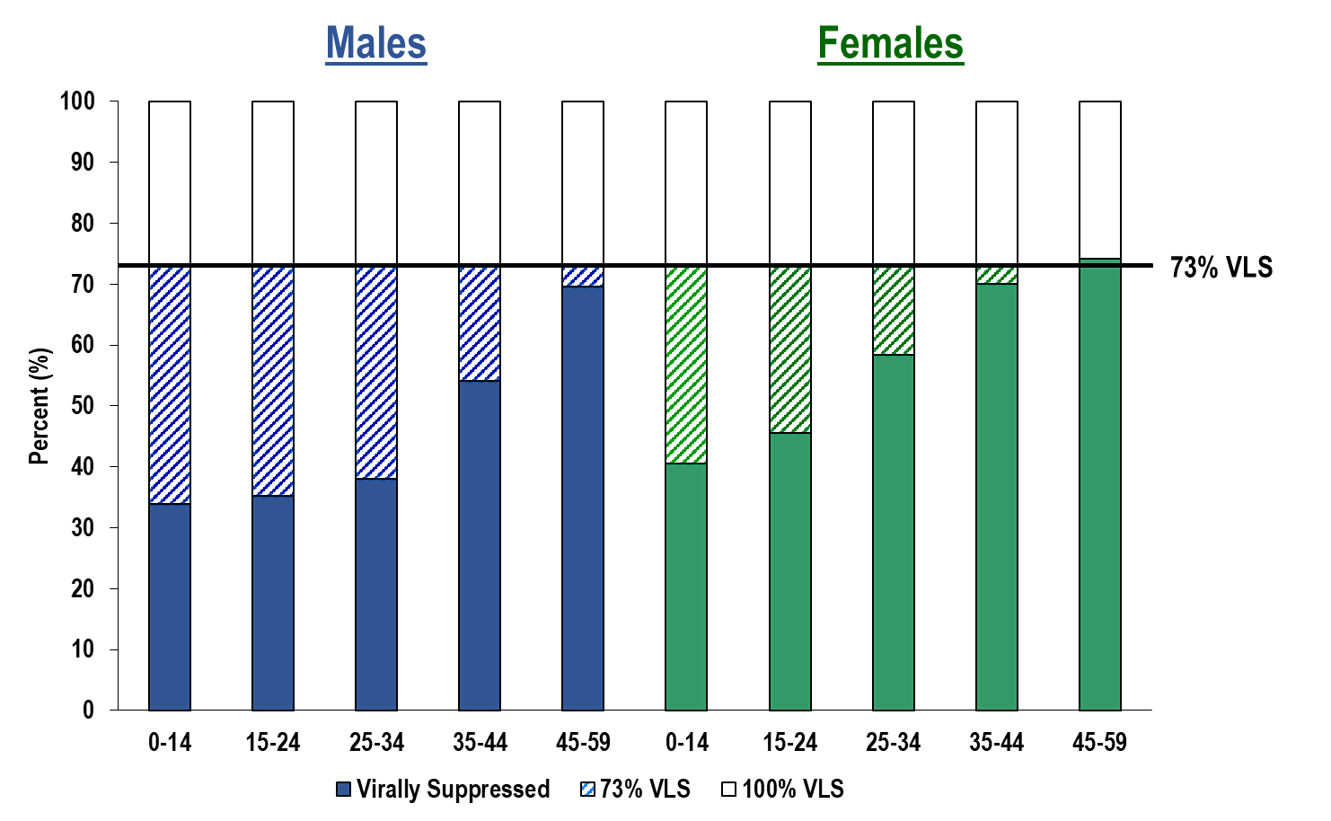
Key Gaps (children, young men 15-34 and young women 15-24) in Reaching Specific Populations Community Viral Load Suppression By Age and Gender
*Pooled data from Lesotho, Malawi, Namibia, Swaziland, Tanzania, Uganda, Zambia, and Zimbabwe from PHIA projects.
Source: Ambassador Deborah Birx “Reaching young women and girls through comprehensive responses ”
TUSS0101

Slide 7
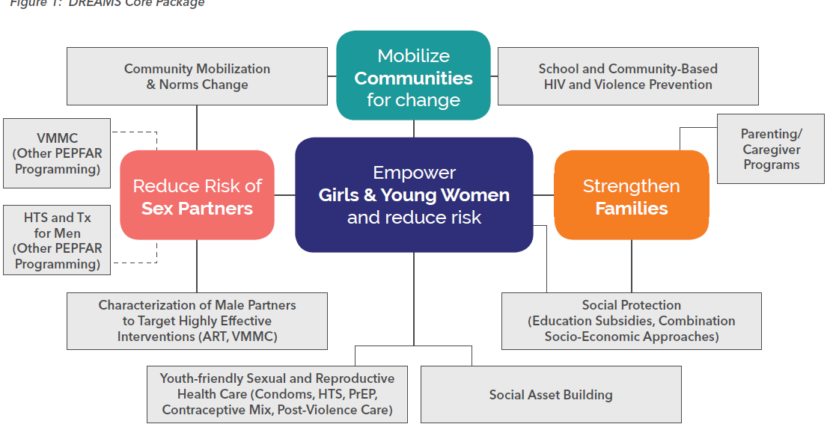
DREAMS Core Package
COP Activities
Source: Ambassador Deborah Birx “Reaching young women and girls through comprehensive responses ”
TUSS0101
Notes:
Talking points:
Some points about the program that have to be taken into consideration as we look at data on DREAMS…
DREAMS involves a COMPREHENSIVE package of programs and services ; these differ by:
Country (little variation across countries; PrEP is the component that some still do not have)
District (little variation across districts within a country)
Age group
Individual needs (not all AGYW need post violence care; AGYW not sexually active don’t need condoms)
DREAMS does not exist in a vacuum
Broader PEPFAR programming
Not just for AGYW, but also for men who are likely to be the sex partners of AGYW
if we decrease the risk of young adult men with our other programming, we reduce risk for AGYW

Slide 8
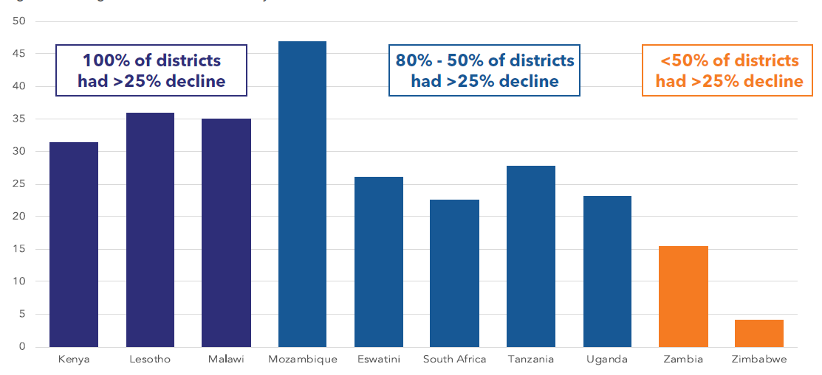
Average Percent Decline in DREAMS Districts
2015-2018 Preliminary Data
TUSS0101
Source: Ambassador Deborah Birx “Reaching young women and girls through comprehensive responses ”
Note: S/GAC is finalizing data.

Slide 9
LINKAGES’ strategic information operational framework
Understand the population and situation
Programmatic mapping, PLACE, IBBS
Performance improvement
Measure outcomes and impact
Use simple approaches
Small area measurements
Microplanning: prevention, test, enroll, retain,
re-engage
Monitor and evaluate
Plan and implement the response
Routine system to measure performance:
data quality, tracking along the cascade,
capacity-building, electronic system
Source: Navindra Persaud “Use of data to monitor and improve key population-focused programming ”
TUSS0104

Slide 10
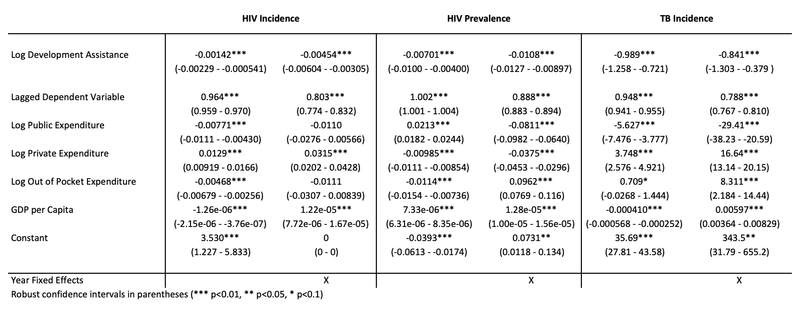
Impact of Development Assistance in 174 recipients
Health Impact – HIV & TB
Between 2000 and 2015 development assistance crowed-in domestic private health investment
Translated to reducing the incidence of TB, prevalence of HIV/AIDS, and mortality
Source: Bryan N. Patenaude, “Do Changes in Development Assistance for Health Crowd out Domestic Investment and What are the Implications for HIV/AIDS outcomes?”
TUAD0301

Slide 11
Involving of the community is critical for programmatic success

Slide 12

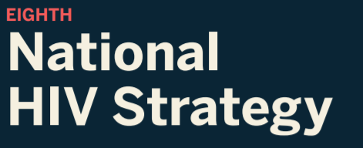
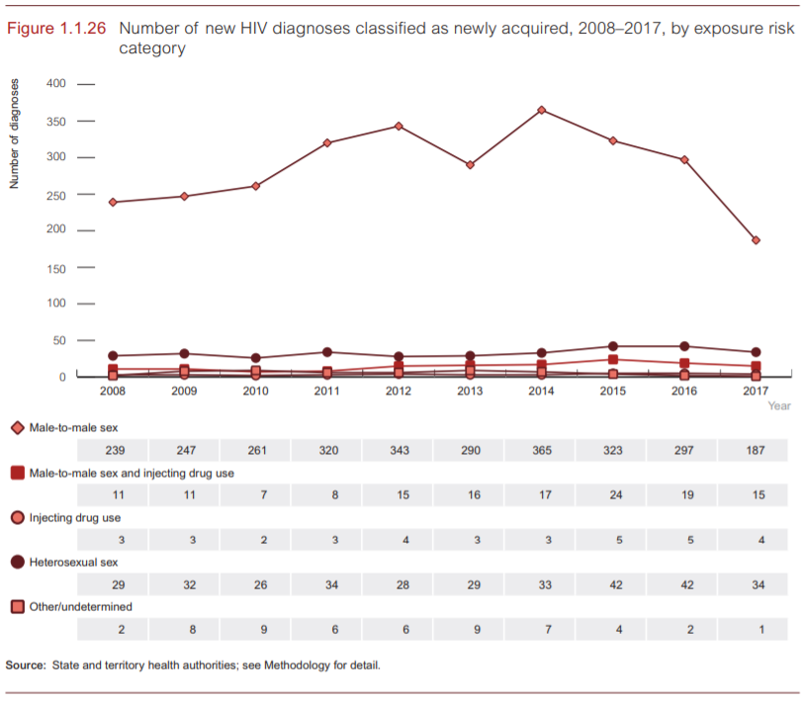
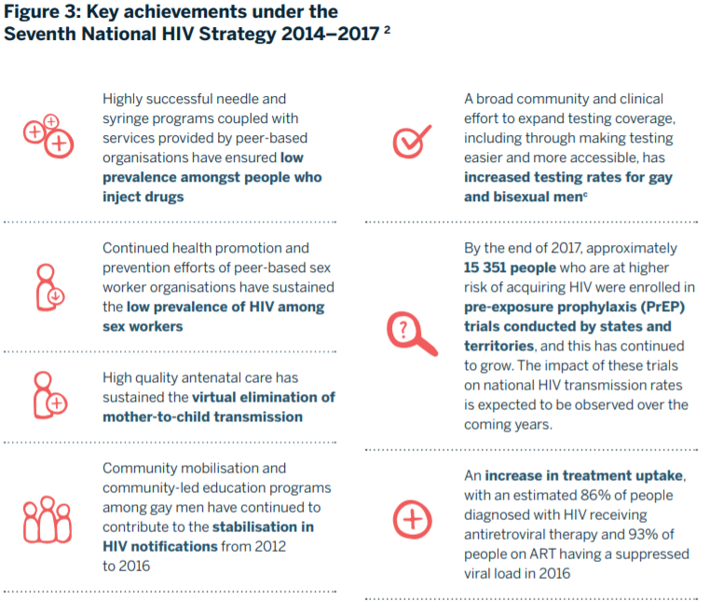
In Australia, HIV prevention programs focused on easy access, peer-based health promotion, and community mobilization leading to 92-97-95+ result.
© The Kirby Institute for infection and immunity in society 2018
Focus on KP:
Successful harm-reduction program
Peer-based health promotion
Community mobilization & engagement
Rapid PrEP scale-up
Accessible and acceptable HTS
& High-quality ANC
92 – 97 – 95+ (2017)*
* Source: UNAIDS special analysis, 2019
Source: Maeve Brito de Mello “Progress on scaling up HIV prevention”
TUBS0103

Slide 13
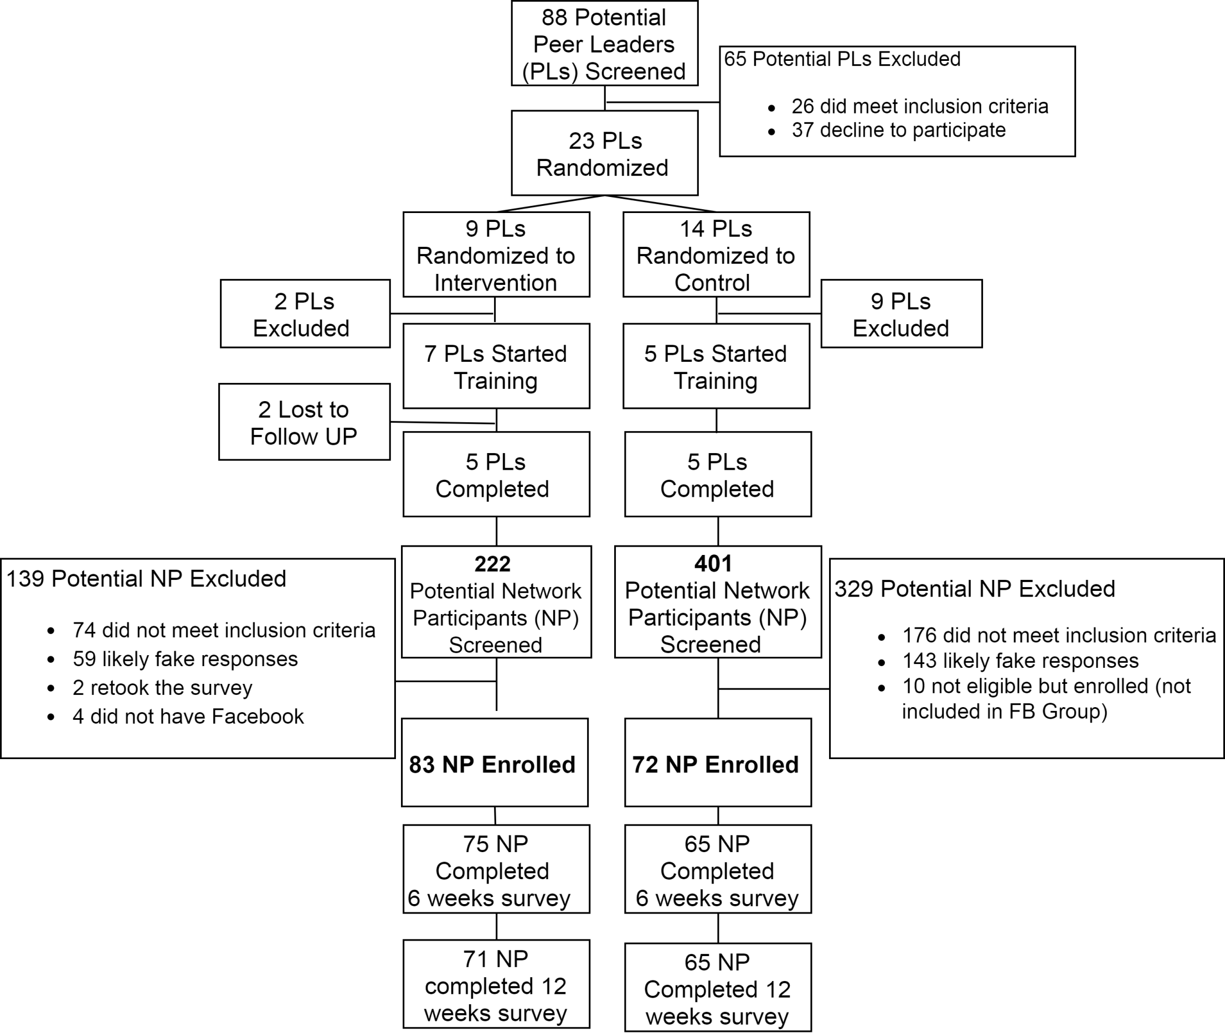
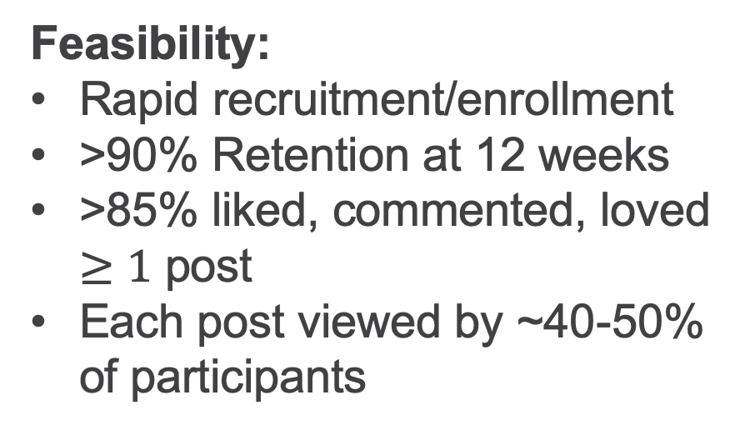
Among Black and Latin MSM leveraging existing social networks in the US
Increased knowledge, communication skills about PrEP use, and reduce PrEP-stigma.
Feasibility:
Rapid recruitment/enrollment
  >90% Retention at 12 weeks
  >85% liked, commented, loved $≥1$ post
  Each post viewed by ~40-50% of participants
Acceptability:
  82% would continue participating,
  78% reported high satisfaction
  75% would recommend friends to participate
MOPDD0203
Source: Viraj V Patel “Empowering with PrEP (ePrEP) - a peer-delivered online social network intervention for PrEP adoption among young Black and Latinx men who have sex with men: Cluster randomized controlled trial"
Notes:
This first flow chart is our Consort diagram. We recruited PI screened 88 Peer Influencers

Slide 14
Community involvement all along. Designing interventions and generating evidence

Slide 15
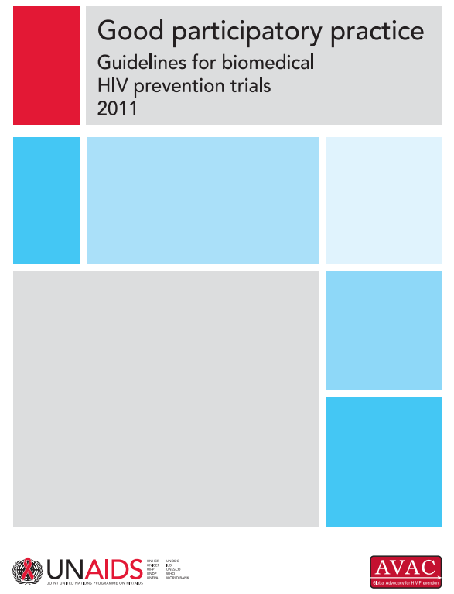

Community engagement in clinical trials
Early and Ongoing
Community Engagement in HIV Prevention Efficacy Trials
The AMP Studies’ Experience (HVTN 704/HPTN 085 & HVTN 703/HPTN 081)
GPP are being applied in pharmaceutical companies
iPrevent study in Cape Town, South Africa
Engaging end-users in the research process before products reach the market
product designers
film-makers
survey designers
analysts and interpreters
Source: Miriam Hartmann “Engaging youth as long-acting HIV prevention product co-researchers in the iPrevent study in Cape Town, South Africa”
TUAD0106
Notes:
Very important to engage the community in clinical trials, such vaccination and prep, good examples were presented
Engaging end-users in the research process before products reach the market is critical
The AMP Studies’ Experience (HVTN 704/HPTN 085 & HVTN 703/HPTN 081)
Community Consultations
Established Community Working Groups
Ongoing communication with studies’ Community Working Groups
Community-Based Participatory Research (CBPR) approach to materials development
Geographically specific materials and websites
Retention Workshops
Cultural Responsiveness Training
Janssen es un ejemplo de laboratorio implementando las Good Participatory Practice

Slide 16
Culturally mindful interventions that address structural complex barriers and problems

Slide 17
Reduction on stigma for testing among men (Sawa Sawa intervention, Mozambique)
Stigma among all participants
Total stigma score decreased with the overall intervention
(β: -2.38; 95%CI: -3.07,-1.69; p <0.001)
  Reductions more pronounced among men (p<0.001)
HIV testing among men
Increased odds of HIV testing among men associated with the intervention
(aOR: 1.32; 95%CI: 1.01-1.74; p=0.049)
  Increased odds of HIV testing in the community (aOR: 1.23; 95%CI: 0.98, 1.53, p=0.073)
Source: Andrea L. Wirtz “The Sawa Sawa Intervention: A quazi-experimental trial to reduce community level stigma and improve HIV testing service uptake among men in Sofala Province, Mozambique”
MOAD0404
Notes:
The endline survey was conducted February to March 2018, surveying 2,447 participants from the baseline and was a retention rate of 81%. A total of 241 reported living with HIV, which comprised 9% of men and 19% of women.
As the community-based survey is a probability-based sample of the population, the survey gives a sense of the coverage of the various Sawa Sawa activities across the intervention communities, as demonstrated in this figure.
[click]
If we focus on the top section of the slide, this tells us about primary exposure- that is direct involvement in any one of these Sawa Sawa activities. Radio programs had the greatest coverage, as over 47% of the sample reported hearing the Sawa Sawa radio programs and spots. Community Dialogue groups reached over one-third of the population while Positive Prevention groups reached almost 30% of PLHIV in the community. A total of 16% of the population were tested via the Sawa Sawa HIV testing campaign; of these, 40% of men reported that they were tested for the first time. In total, 60% of the population was exposed to at least one Sawa Sawa activity, with no difference by gender. Importantly, with HIV interventions, we often observe that women tend to have more exposures to HIV interventions, but here we generally see no difference across gender when we look at any primary exposure to Sawa Sawa. [click]
Turning our attention to the bottom half of the slide, we can also assess secondary exposure to the intervention – this was measured by asking participants who did not participate in Sawa Sawa activity if they had a discussion about the activity and its content with anyone who had participated. In this case, we see that Sawa Sawa messages continue to be shared even with those had not directly participated.

Slide 18
Another example of multi-level interventions: effect of consistent access to school feeding on delay of risk sexual behaviours in South Africa
MOAD0403
Source: Elona Toska “Dreams of an AIDS-free generation: Which supportive factors delay onset of adolescent sexual HIV-risk behaviors in South Africa ”

Slide 19
Laws and context exacerbate or alleviate vulnerability and risk

Slide 20
Laws Shaping HIV response
Using individual level data to characterize the relationship between HIV infection and the legal context of sex work across 10 countries in sub Saharan Africa
Source: Carrie Lyons “Utilizing individual level data to characterize the relationship between HIV infection and the legal context of sex work across 10 countries in sub Saharan Africa ”
MOAD0103
Notes:
Conclusion General de la sesion
Criminalization of behaviours and punitive laws are associated with HIV infection, and engagement with HIV cascade. Policies help to increment or reduce social stigma.
Human-rights affirming policies as part of an effective HIV response
MOAD0103 Utilizing individual level data to characterize the relationship between HIV infection and the legal context of sex work across 10 countries in sub Saharan Africa
Realizo un trabajo The Role of Stigma and Sex Work Laws, encontro The influence of stigma contributes to the HIV infection across legal settings.
The influence of policies was also shown in other key populations, such as transgender people, drug users.
MOAD0101 Systematic Review - show how policing practices are consistently associated with HIV infection/risk behaviors among people who inject drugs in many settings.
Need data from entire regions

Slide 21
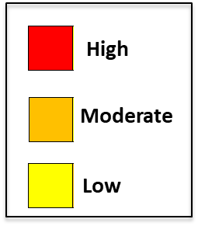
Network influences on substance abuse and HIV
Alcohol and drug consumption is higher among white men, however the HIV prevalence is a lot higher among African American (32% vs 2%)
Source: Brian Mustanski “Network Influences on Substance Use and HIV among Young Men who have Sex with Men in the US”
MOSY0202
Notes:
*Homophily—or the tendency to have sex partners from one’s own racial group—can amplify and sustain long-term prevalence differentials that arise from other social, behavior, or biological average differences between racial groups. When assortative mixing is high, particularly in a relatively small population with high
HIV prevalence, HIV can be rapidly transmitted to a large proportion of that population, thereby magnifying and sustaining disparities in incidence.
*Sexual network density, assesses overall network connectedness, and is operationalized as the proportion of actual sexual ties among people from all possible sexual ties. Where sexual networks are denser there are more opportunities for transmission.

Slide 22
Stigma and decisions:
Impact of stigma along the cascade

Slide 23
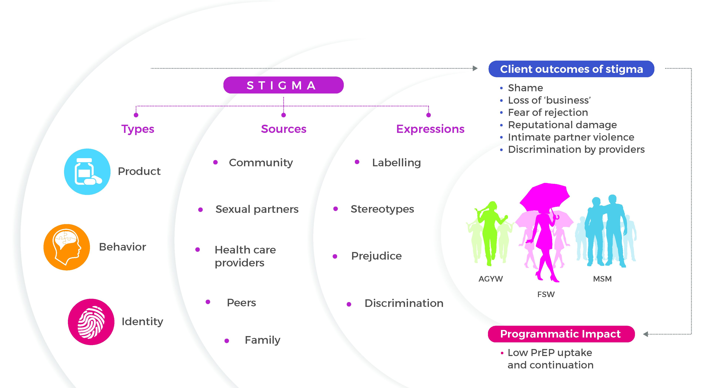


Summary of Key Findings
Source: Daniel Were “Manifestations of Stigma in the Context of a National Oral Pre-exposure Prophylaxis Scale-up Program in Kenya “
MOAD0302

Slide 24
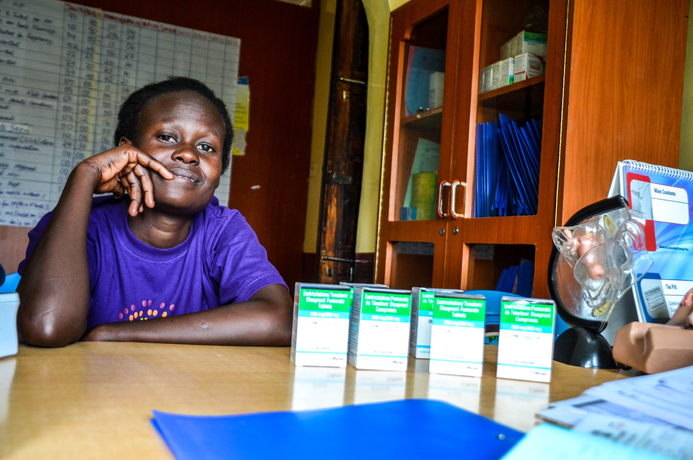

Types of Stigma
1
Product stigma
“I have kept it a secret because the bottle is similar to that of ARVs. Someone who doesn’t know about PrEP could think you have HIV…”
(20 year old, AGYW PrEP user)
Source: Daniel Were “Manifestations of Stigma in the Context of a National Oral Pre-exposure Prophylaxis Scale-up Program in Kenya “
MOAD0302

Slide 25
25% discontinuation in PrEP and its predictors in Australia
 |  | HR (95%CI) | aHR (95%CI)
Age | 16-29 | 1.82 (1.53-2.16) | 1.75 (1.47-2.09)
 | 30-39 | 1.41 (1.19-1.68) | 1.39 (1.17-1.65)
 | 40+ | Ref | Ref
Trans or gender diverse |  | 1.73 (1.04-2.87) | 1.45 (0.87-2.42)
PrEP naïve at baseline |  | 1.51 (1.28-1.79) | 1.44 (1.21-1.71)
Injecting drug use ^{1,2} |  | 1.55 (1.20-2.01) | 1.64 (1.23-2.19)
Methamphetamine use ^{1,2} |  | 1.23 (1.02-1.47) | 1.34 (1.11-1.61)
Enrolled at clinician discretion |  | 1.20 (1.05-1.38) | 1.27 (1.04-1.55)
Three month recall
Reasons for enrolment not mutually exclusive
Covariates not significant at univariate level include condomless anal sex, Site type
Source: Kathleen Ryan “Results from a large Australian PrEP demonstration study: discontinuation and subsequent HIV and other sexually transmitted infection risk”
MOAD0303

Slide 26
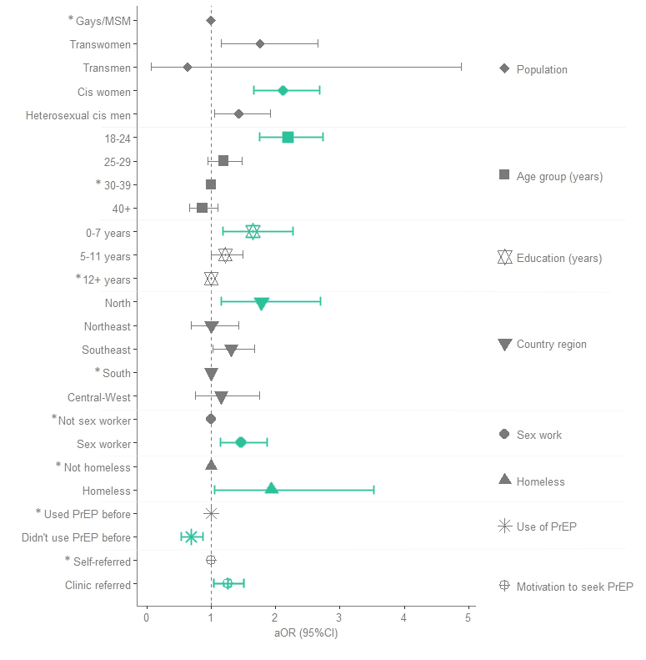
13% PrEP discontinuation in Brazil; predictors
MOAD0304
Source: Isabela Ornelas Pereira “Predictors of discontinuation in Brazil's free-of-charge PrEP program”

Slide 27
Intervention Level
Carrie Lyons. Using implementation research to assess stigma mitigation interventions in low- and middle-income countries.
Most were a pilot or once-off implementation
Source: Carrie Lyons “Using implementation research to assess stigma
mitigation interventions in low- and middle income
countries”
WEBS0105

Slide 28
Recommendations
Implementation science could support the dissemination of stigma reduction interventions
Promote the rigor of future stigma implementation research
Source: Carrie Lyons “Using implementation research to assess stigma
mitigation interventions in low- and middle income
countries”
WEBS0105

Slide 29
Key messages
Accurate and timely data is the core of good programming
Involvement of the community is critical for programmatic success
Culturally mindful interventions that address structural complex barriers and problems
  Stigma and decisions – impact of stigma along the cascade
Laws and context exacerbate or alleviate vulnerability and risk
Social and Behavioural Science is underfunded (Warren M.)

Slide 30
Thank you

